Slide 1
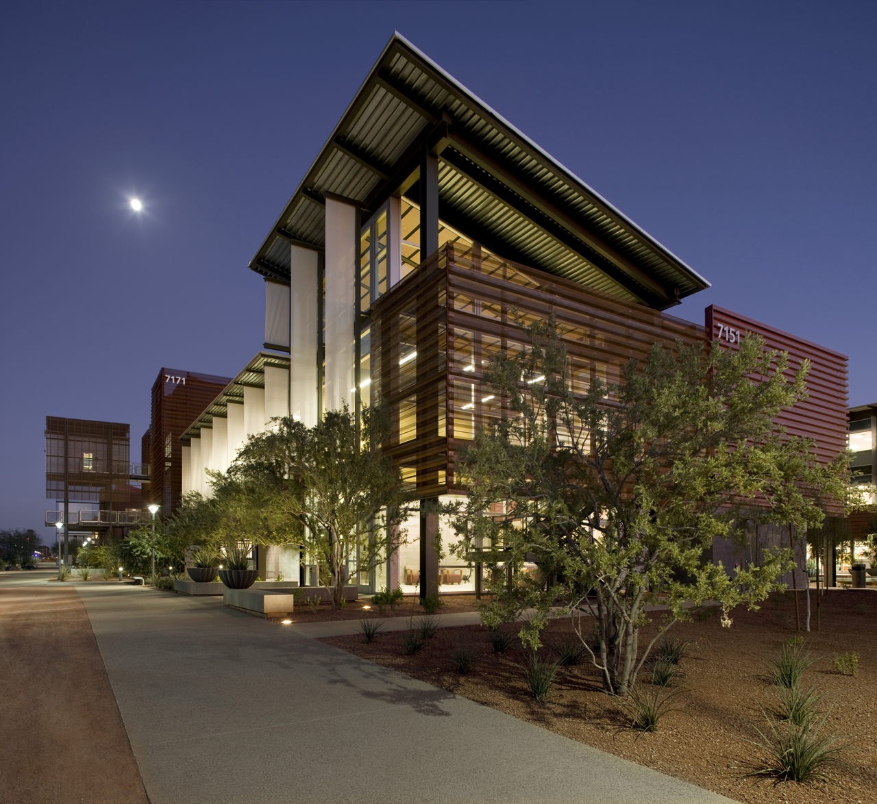
Senate report
AI news
Poly expansion
Personnel news

Slide 2
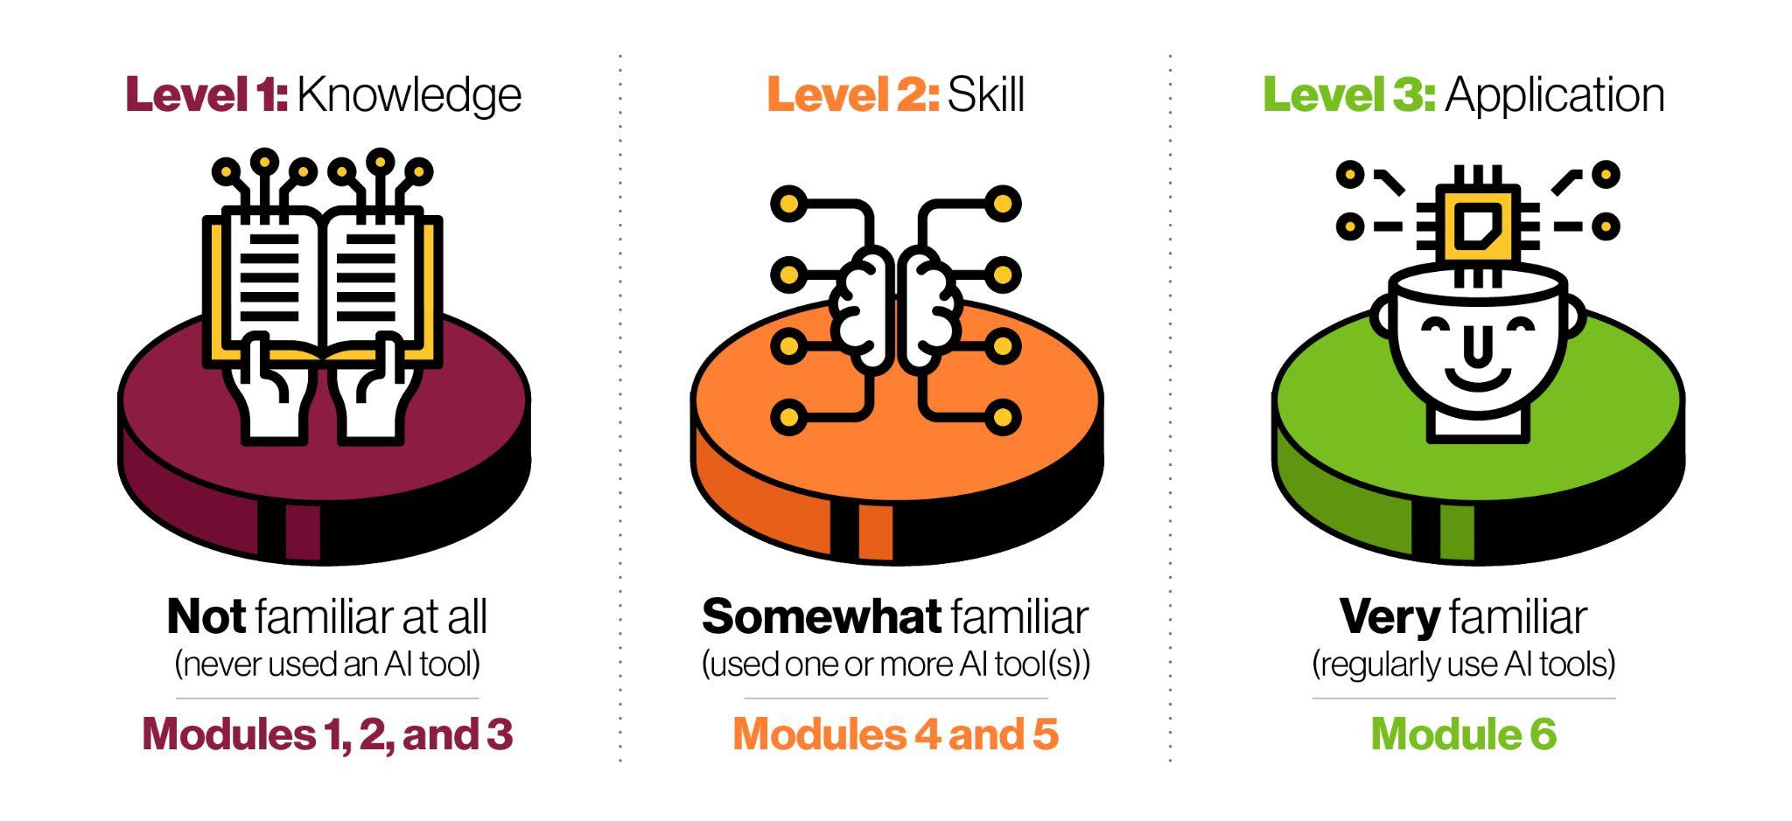
Faculty GenAI Literacy Course
Launched fall 2023
>1500
49
Modules
Fundamentals of Generative AI
Awareness of Generative AI Applications
Ethical and Responsible Use of Generative AI
Designing Prompts for Generative AI
Evaluating Outputs from Generative AI
Integrating Generative AI with Teaching and Learning
Faculty, staff and student workers enrolled
ASU Experts Contributing to the Course
https://ai.asu.edu/asu-programs
Created via contributions from AE, ET, and EdPlus

Slide 3
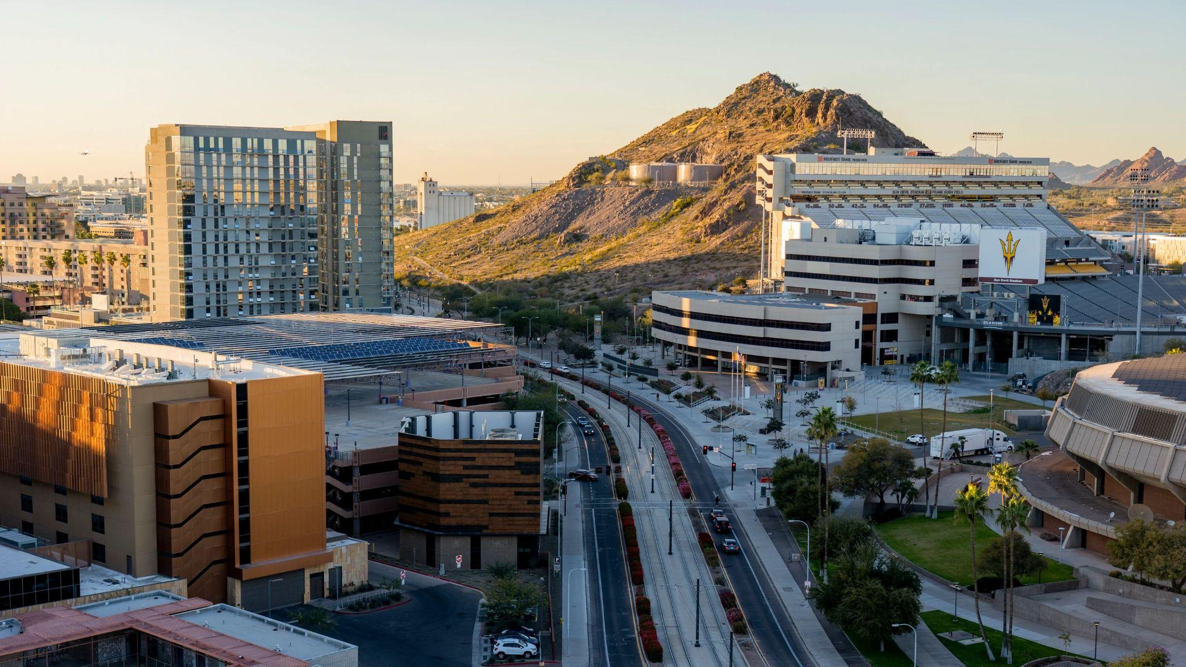
Guidelines, Tools and Policies
Digital Trust Guidelines for Generative Artificial Intelligence Use
https://ai.asu.edu/digital-trust-guidelines
These guidelines have been reviewed and approved by Enterprise Technology Digital Trust, Cybersecurity, AI Acceleration, Learning Experience and the Office of General Council.
Generative AI Tools
https://ai.asu.edu/generative-ai-tools
View the generative AI tools that have completed the ASU VITRA process and are approved for use at the departmental level.
Academic Integrity: Syllabus Guidelines
https://docs.google.com/document/d/1u9RGD8oU3e16XkdFNC6k8tgXIzYW2L7yZ2ELW5LfZqQ/edit
Notes:
Find additional images to use for this slide

Slide 4
OpenAI Collaboration Call for Proposals
February 1st a form to submit for the AI Innovation Challenge will be released for faculty, staff and researchers to submit proposals for ChatGPT Enterprise access. Proposals will be evaluated on alignment to charter, potential for impact, innovation and originality and comprehensiveness of assessment plan.

Slide 5


ai.asu.edu
This website serves as a showcase and central hub to highlight the multifaceted impact of augmented intelligence (AI) on learning, research, and work. Outlining the enterprise’s holistic approach to AI, it provides compelling success stories, valuable resources, and opportunities for active participation.
Access other teaching resources including Syllabus language, Library Guides for Academic Integrity, Gen AI citations, Plagiarism, etc.

Slide 6
ASU Poly Expansion
New schools established in the last year
College of Integrative Sciences and Arts
School of Applied Professional Studies
School of Applied Sciences and Arts
School of Counseling and Counseling Psychology
Ira A. Fulton Schools of Engineering
School of Manufacturing Systems and Networks
+17.5% enrollment growth on the Polytechnic campus from fall 2020 to fall 2023, an increase of 906 students

Slide 7
Personnel News
Tuesday, February 13, 2024 - 2 to 4 p.m. – Tempe campus (Fulton 6440)
Promotion to Full: Thursday, February 22, 2024 - 10 a.m. to 12 p.m. – Zoom
Monday, February 26, 2024 - 10 a.m. to 12 p.m. – West Valley campus (Sands 231)
Tuesday, March 12, 2024 - 2 to 4 p.m. – Polytechnic campus (Peralta 313)
Tuesday, March 19, 2024 - 10 a.m. to 12 p.m. – Downtown Phoenix campus (Cronkite 444)
Friday, April 5, 2024 - 3 to 5 p.m. – Tempe campus (Fulton 6440)
Thursday, April 11, 2024 - 3 to 5 p.m. – Zoom
March career track FWA
Zoom/in person career track workshop

Slide 8

FWA

